Slide 1
Advanced Materials and Manufacturing – A Pillar of UT Research IACMI Members Meeting June 21, 2023
Notes:
Deb charged us to develop a strategic plan
Moving forward, chart a path
Where do we want to be in 5-10 years and beyond

Slide 2

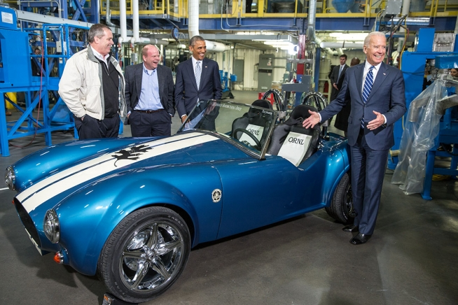

Notes:
As we grow in achievement and reputation, we also want to improve student resources and experiences.

Slide 3

Making Life & Lives Better In Tennessee & Beyond
Marc Gibson
Associate Vice Chancellor for Research, Innovation & Economic Development

Slide 4
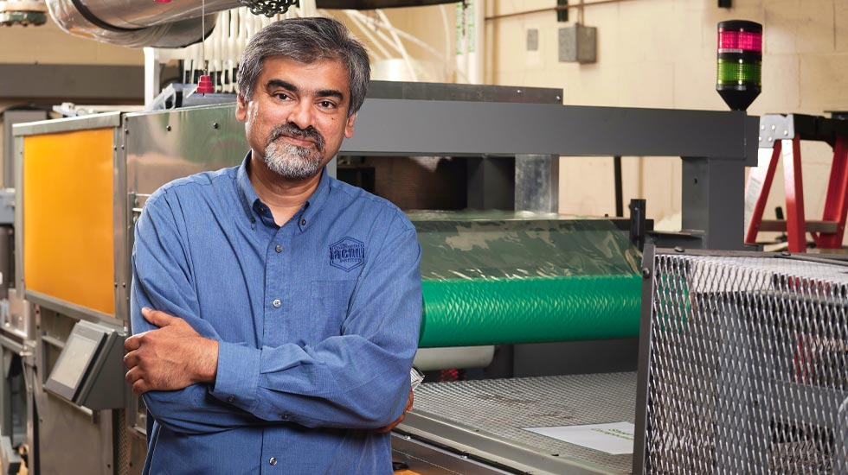
“IACMI with its 130+ member partners brings unique opportunities to East TN and beyond to engage and collaborate with industry on tangible pre-commercialization R&D projects. UT students, faculty and staff engage directly on industry relevant projects on light weighting, energy, next generation materials and manufacturing applied to automotive, wind, gas storage, infrastructure, power, health care, sporting and industrial sectors. Their work is creating a trained work force and holistic solutions for the US competitiveness in next generation processes and products.”
– Uday Vaidya

Slide 5
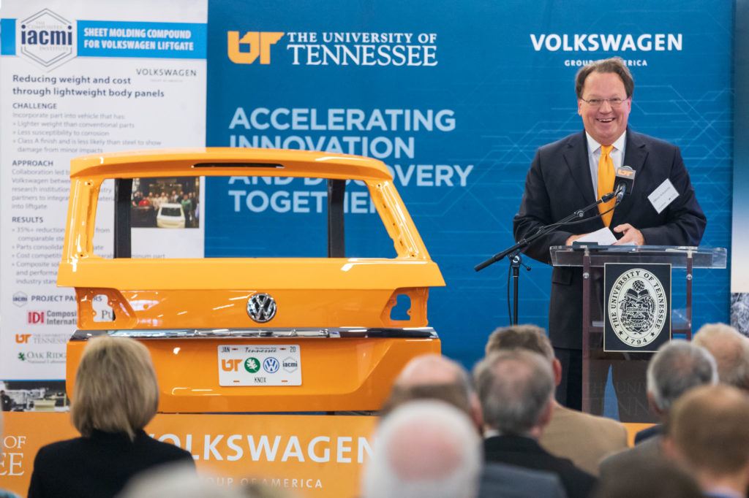

Volkswagen Atlas Liftgate Project
Reducing weight and cost through lightweight body panels
35%
Reduction in weight from comparable steel part
Cost competitive with comparable aluminum part
Through the substantial weight saving, a reduction in use-phase emission was proven
production costs less than aluminum version of the lift gate

Slide 6
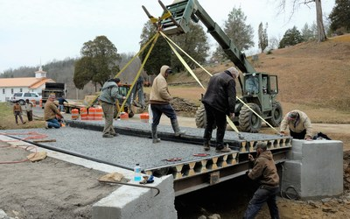
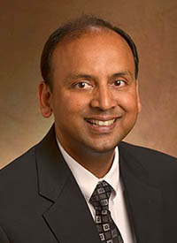
New Composite Bridge Showcases Sustainable Solution for Rural Community.
Fiber-Reinforced-Polymer Smart Composite Bridge Deck
With built-in sensors, this SMART bridge can be monitored to ensure stability and performance.
U.S. bridges are structurally deficient or obsolete
- Dayakar Penumadu
^{150,000}

Slide 7
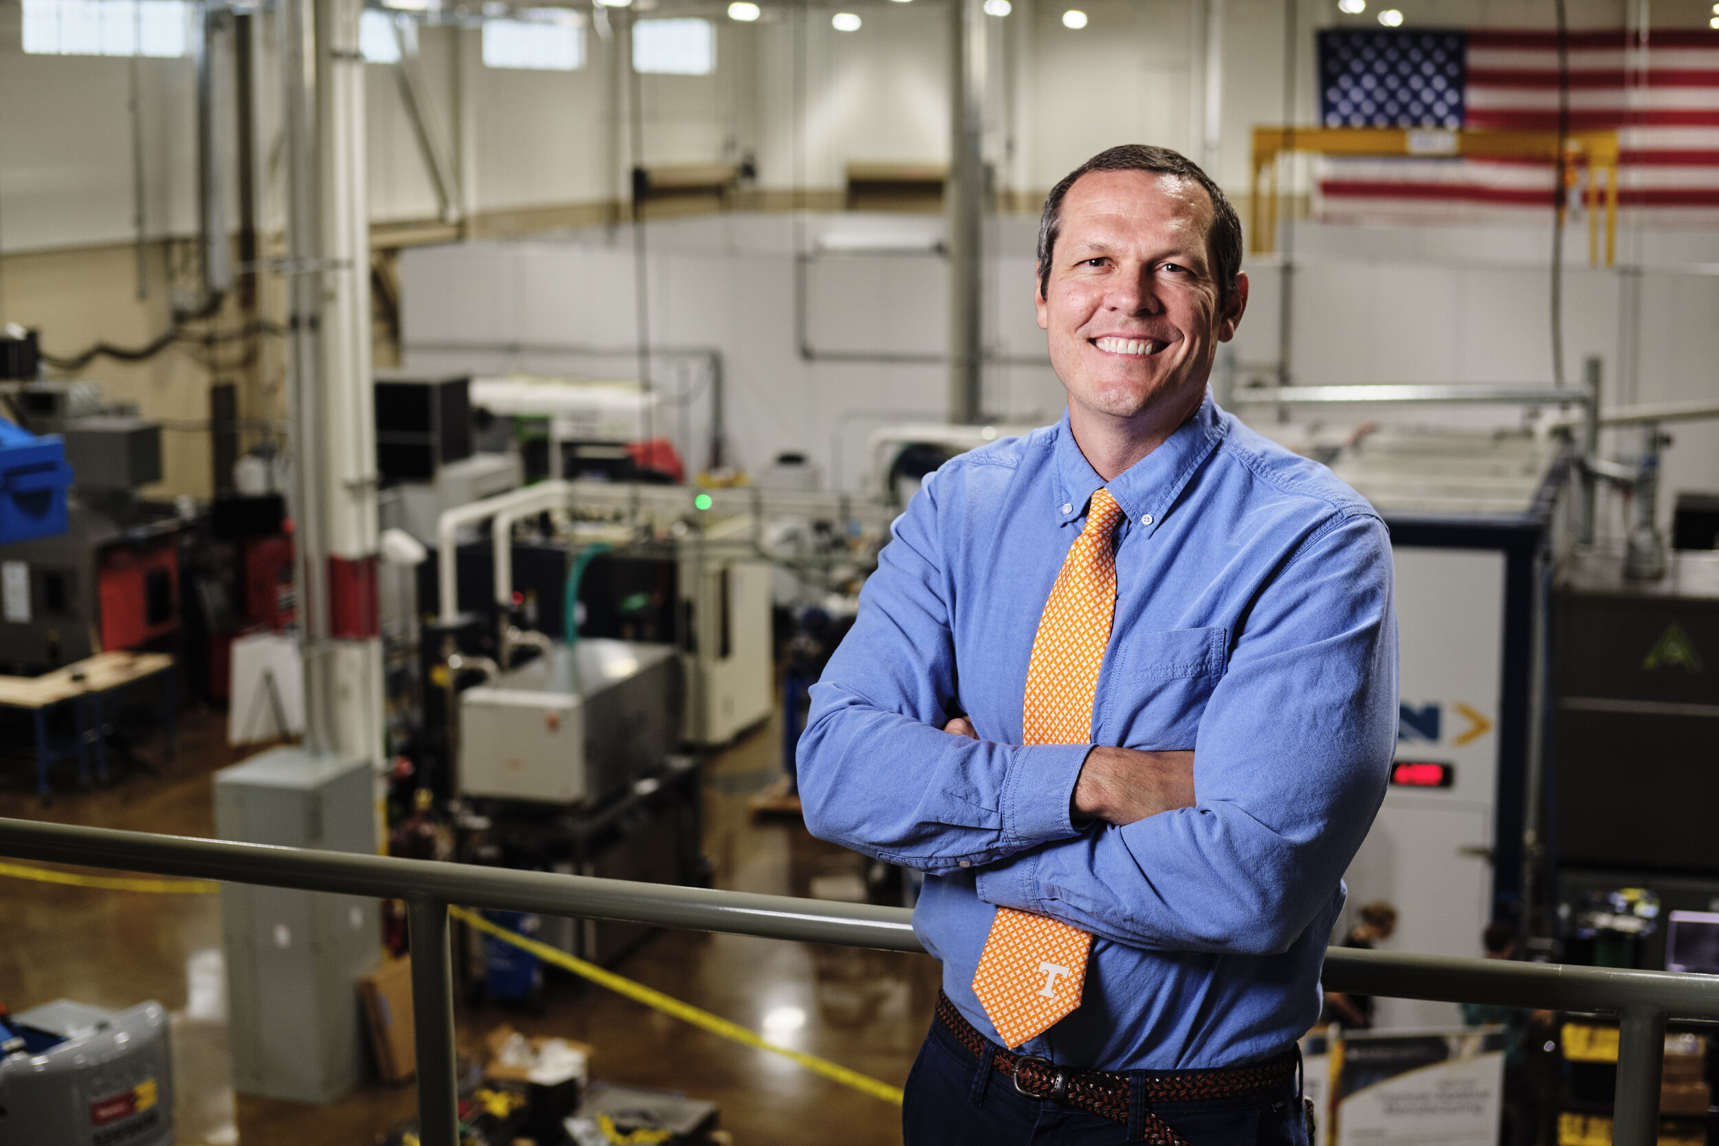
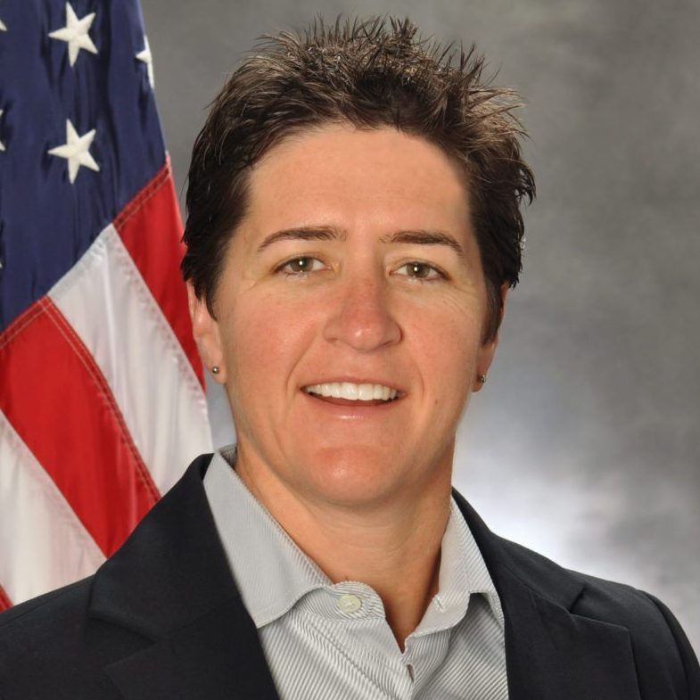

America’s Cutting Edge is supported by the Department of Defense
“ACE is intended to help the United States recover the technical and manufacturing leadership position and enable our ability to design and make the machine tools required to produce so many of the products that are used in modern society.”
Adele Ratcliff IBAS Program Director
Notes:
Workforce Development
Practical Implementation
High School to Graduate Levels
Machining and hybrid manufacturing to produce discrete components in the aerospace, automotive, and biomedical industries from the micrometer to meter scales.

Slide 8
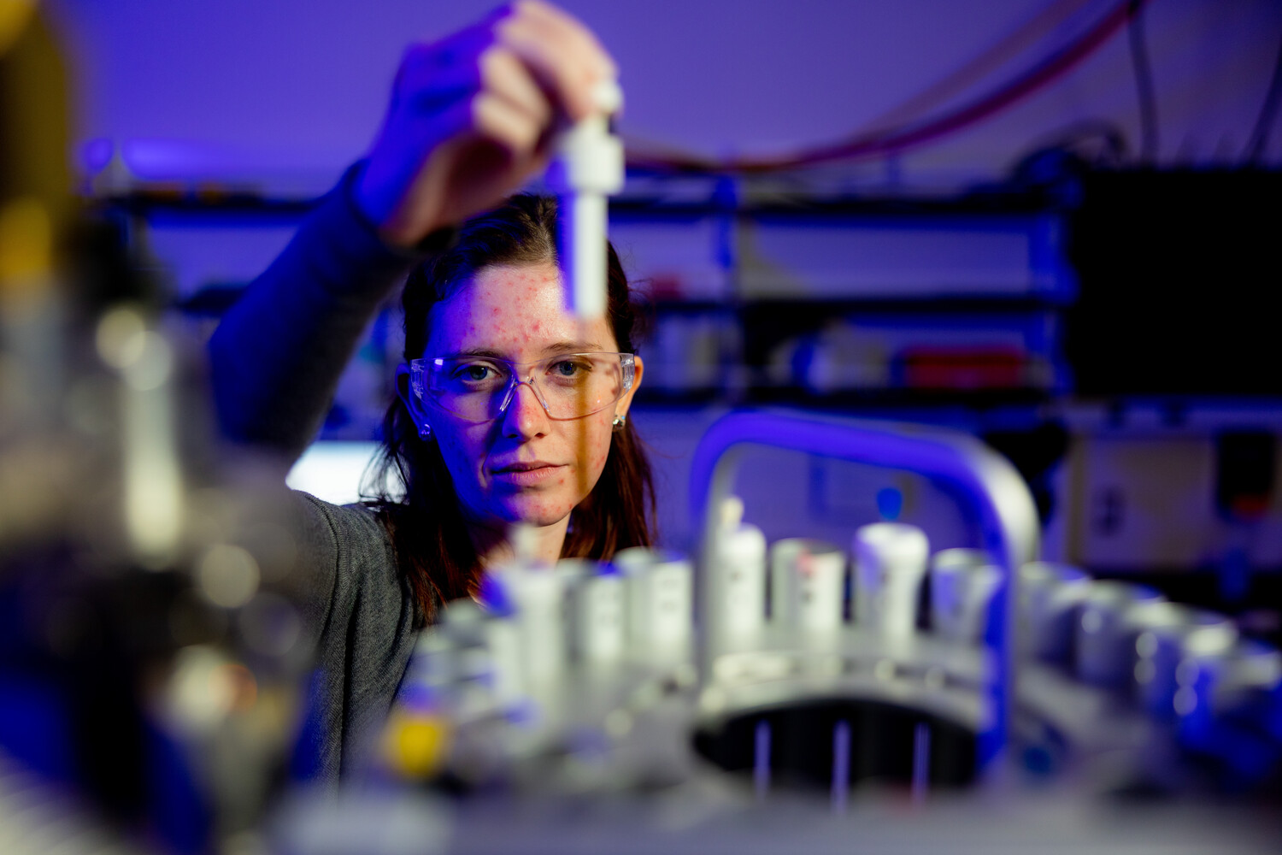
A New Research Strategy
UT has launched an ambitious new strategy to grow our research enterprise and impact.
We are focusing resources on higher dollar interdisciplinary proposals that leverage our strengths.
The strategy is paying off— we have already surpassed last year’s record for proposals submitted and awards received.

Slide 9
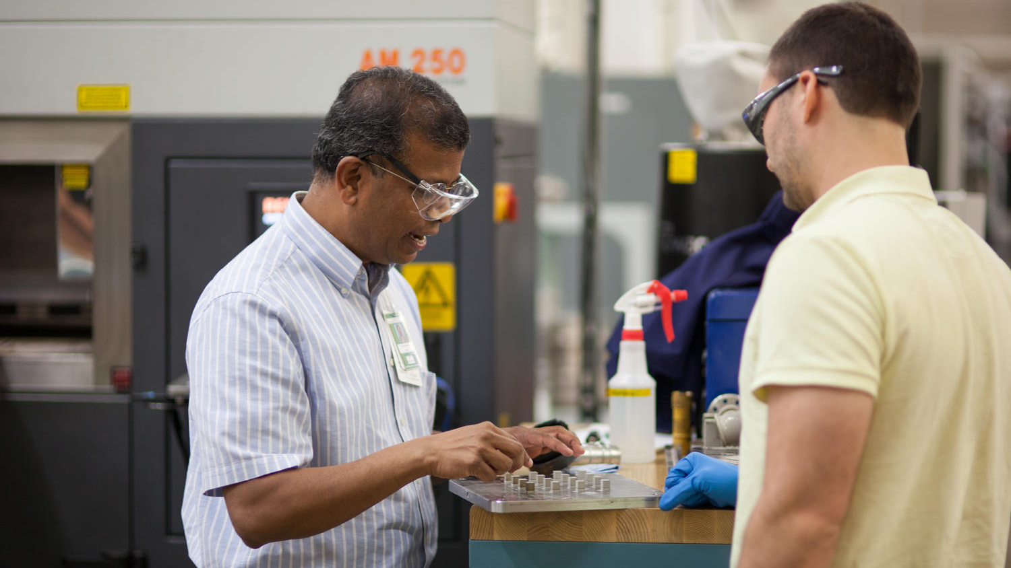
Strategic Research Initiatives
Most of our momentum is coalescing around five key strategic priorities. By focusing on these multidisciplinary initiatives, we leverage existing strengths and resources while building capacity and increasing impact.
They are:
Advanced materials and manufacturing
AI and Collaborative Intelligence
Energy and environment
Human health and wellness
Future mobility

Slide 10
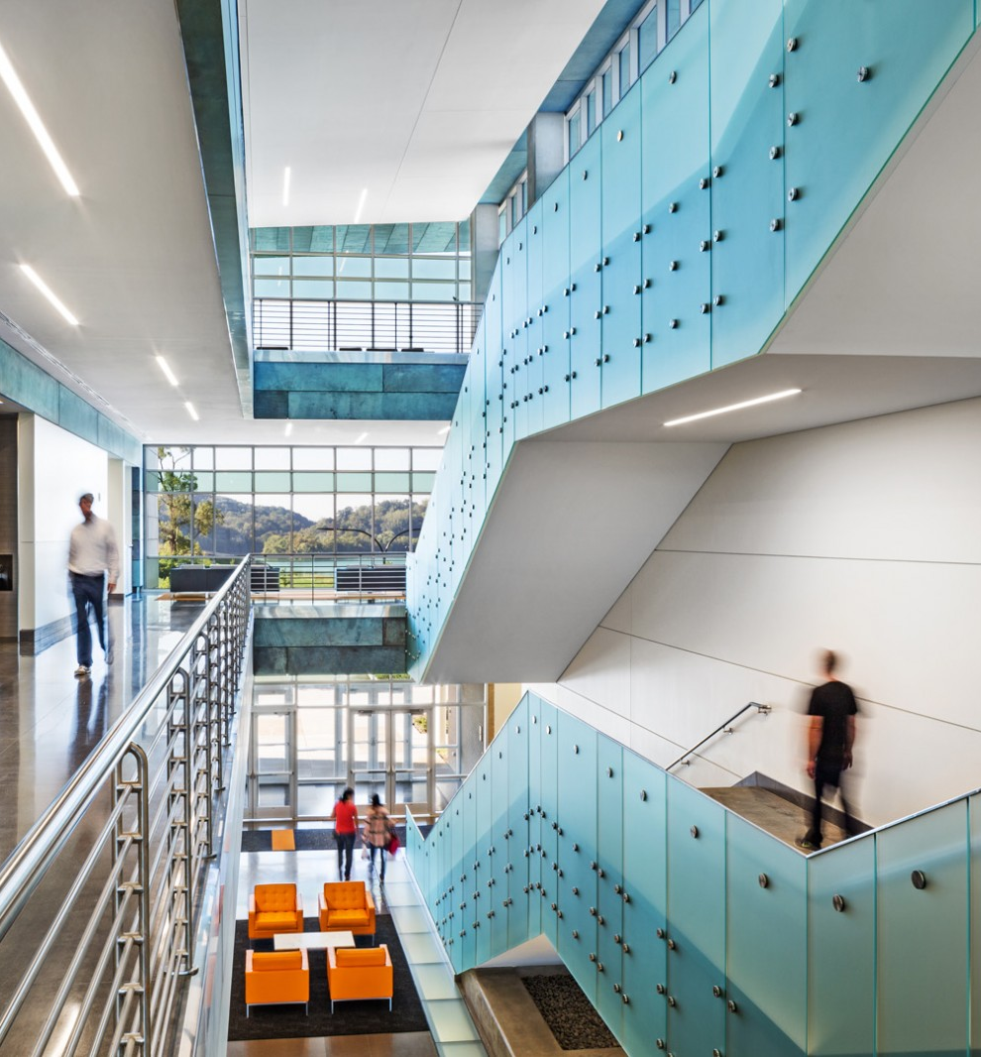
UT Institute for Advanced Materials and Manufacturing (IAMM)
Whether it is synthesis and characterization of a novel material or improving efficiency and capacity in manufacturing, the work at UT IAMM has global impacts and helps create a more just, equitable, and prosperous society.
200
Faculty Researchers
11
Departments Represented

Slide 11
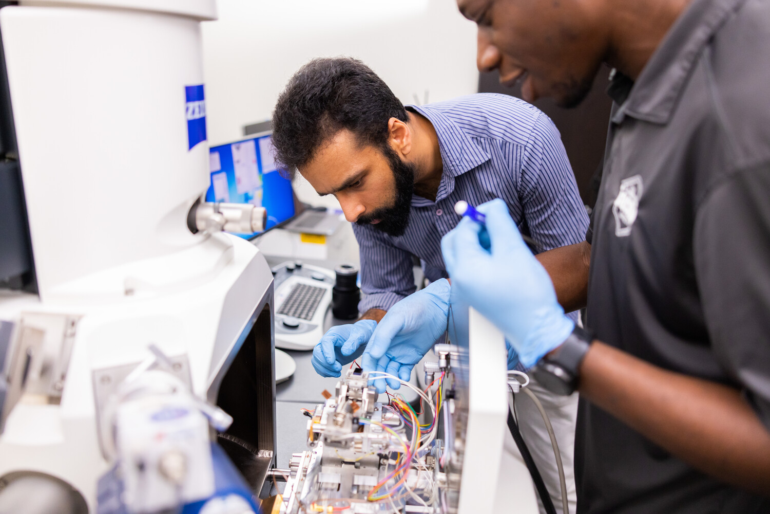
Additional research awards
UTIA has received $50M from the state through the American Rescue Plan to make upgrades to equipment and innovation infrastructure at AgResearch centers across the state.
$18M NSF MRSEC Center for Materials and Manufacturing (CAMM) focused on AI, Quantum and Energy Materials.

Slide 12


Additional research awards
UT will lead an NSF-funded statewide P3 coalition to strengthen TN’s Innovation economy and secure the state’s leadership role in mobility and adjacent industries.
The $1M Regional Innovation Engine development award funds creation of a roadmap positioning TN to compete for $160M in funding to capture a larger share of the $2T mobility market.
UT is a core partner on two other NSF Regional Innovation Engine development awards

Slide 13
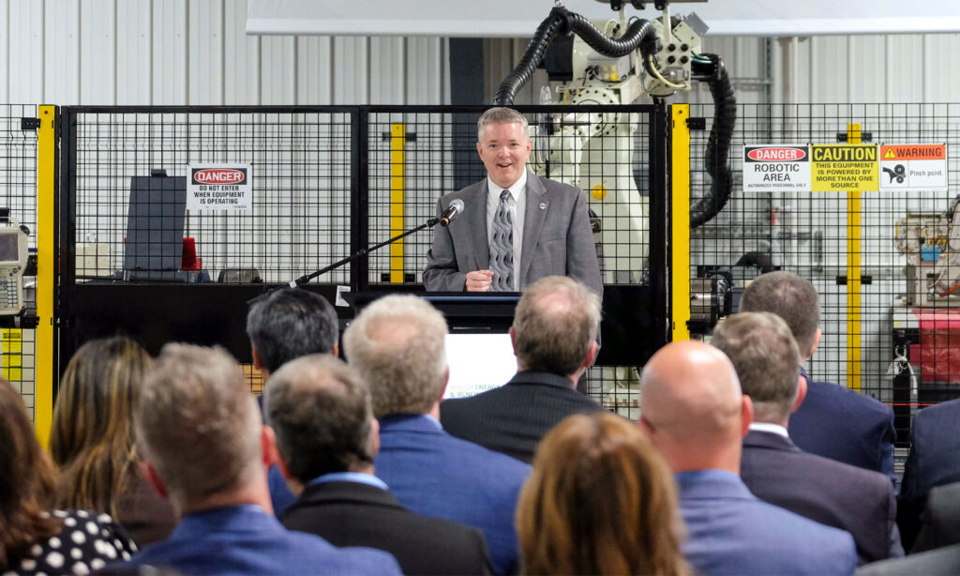
IACMI Receives Funding Renewal from the U.S. Department of Energy to Continue Composite Research and Development

Slide 14
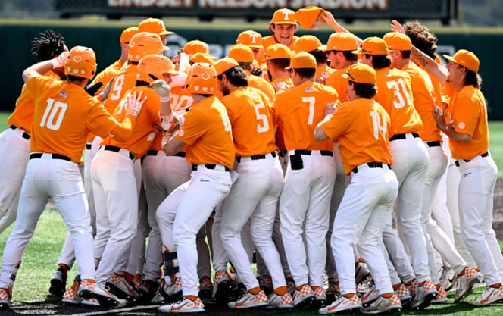
Celebrating Athletics Success
Named All-Sport SEC Champions for second year in a row.
Currently No. 8 in Director’s Cup Standings, last updated in April.
Softball in the Women’s College World Series; Baseball headed to Super Regional.
Only school to rank in top-10 in attendance for football and men’s and women’s basketball.
Notes:
For the second straight year, UT has been named All-Sport SEC Champ by USA Today.
Currently ranked 8th in Director’s Cup
Last updated in April, so baseball, softball, Track & Field all still to be added.
Finished 13th last year.
Student-athletes had the best academic semester in Tennessee history, posting a collective 3.38 GPA and record highs for both men’s and women’s sports.
All 16 programs had team GPA above 3.0
422 student athletes received a 3.0 or higher (most ever, 76%)
202 students named to Dean’s list
Tennessee is only school to rank in the top-10 in attendance for football, both basketball programs, and baseball.
Softball went to WCWS and advanced to semifinals.
Baseball headed to Super Regional for third straight year.
Men’s and women’s swimming and diving both finished in Top 8.
Men's and women's basketball finished Top 25
Football finished No. 6 and won Orange Bowl.

Slide 15


Marc Gibson
Associate Vice Chancellor for Research, Innovation & Economic Development
865-250-0960 mobile
865-974-7592 office
mgibson4@utk.edu
Thank you!

